Slide 1
Measuring Bias of News/Media Outlets

Slide 2
Known News/Media Outlets with Known Bias
Some media bias charts come from surveys in which people are polled about their News/Media preferences (almost always subjective)
Some media bias charts come from studies done by journalists, researchers, experts in Journalism, etc. (can be somewhat subjective and not 100% objective)
Static Media Bias Charts:
https://www.allsides.com/media-bias/media-bias-chart
https://adfontesmedia.com/product/media-bias-chart-latest-edition/
https://libguides.willamette.edu/c.php?g=697656&p=4958591
Interactive Comprehensive Media Bias Chart:
https://adfontesmedia.com/interactive-media-bias-chart/

Slide 3

https://www.allsides.com/media-bias/media-bias-chart

Slide 4
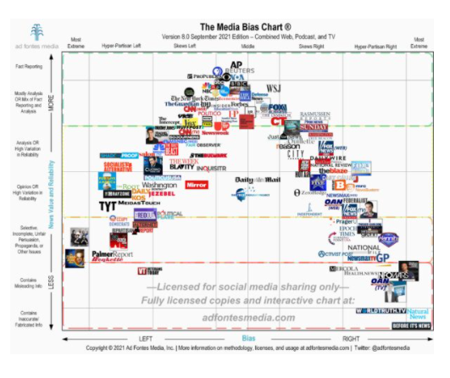
https://adfontesmedia.com/product/media-bias-chart-latest-edition/

Slide 5
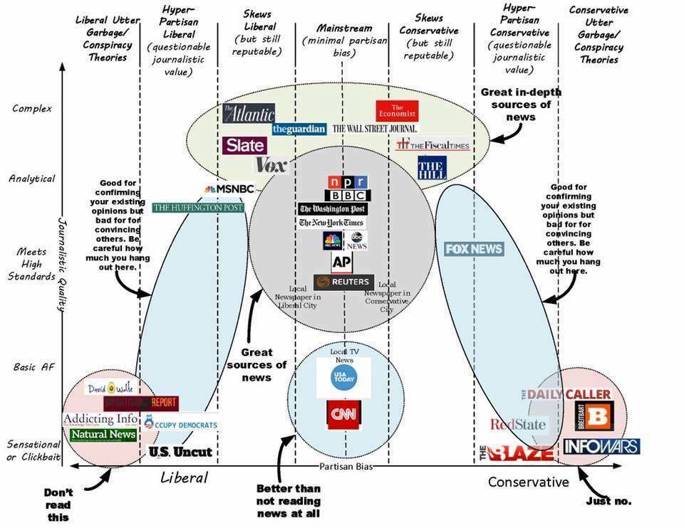
https://libguides.willamette.edu/c.php?g=697656&p=4958591

Slide 6
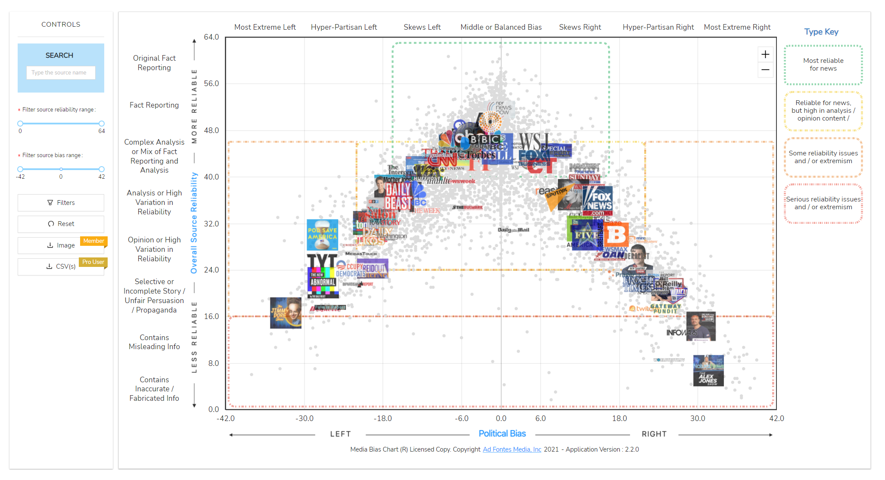
https://adfontesmedia.com/interactive-media-bias-chart/

Slide 7
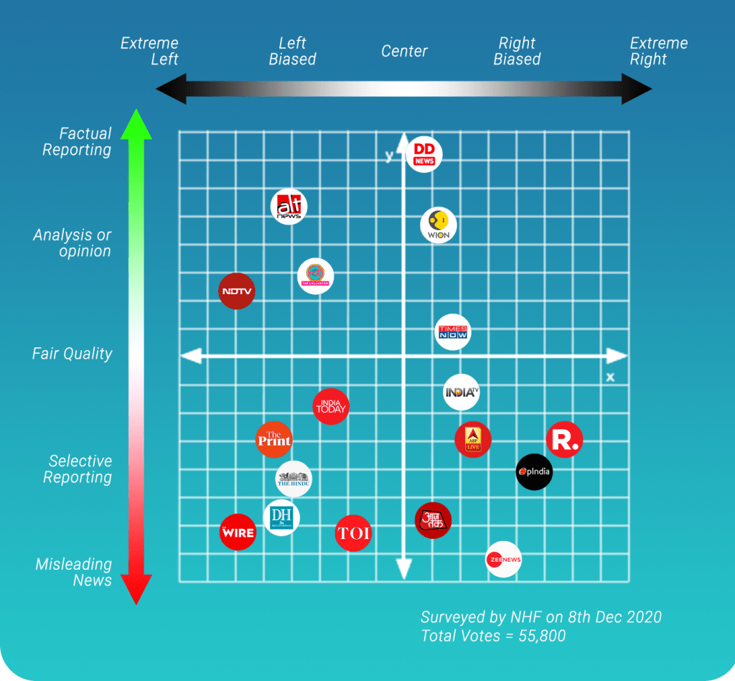
Countries other than US
https://newsheadlinesfixed.com/the-most-accurate-indian-media-bias-chart-2020/

Slide 8
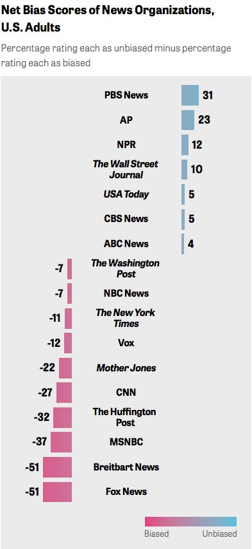
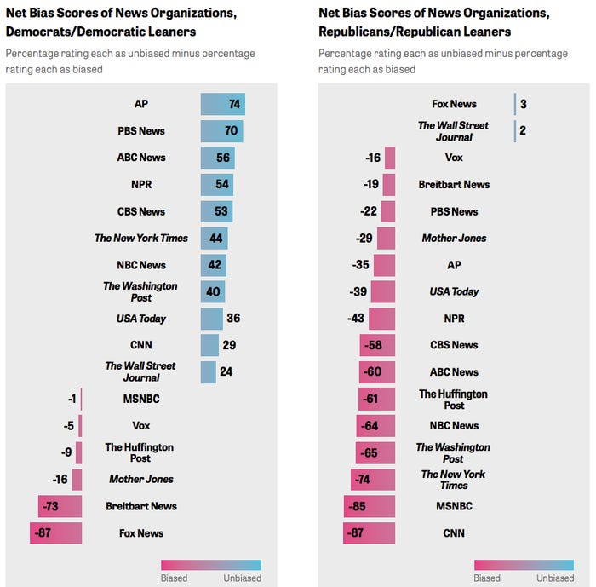

Slide 9
Proposed research questions:
Can we produce a Media Bias Chart for news websites/outlets that has not been surveyed based on the similarities of textual data with news outlets that has been surveyed or went under researchers’ studies?
Can we apply the same method to produce a Media Bias chart from Arabic news websites/outlets based on their similarities with English ones?
Can we produce a mapping between English news outlets and Arabic ones?

Slide 10
Textual Data Sources:
News Outlet’s Website:
1. Site Map
2. RSS feed
3. Scrapping Homepage
News Outlet’s accounts on social media (Twitter, etc)
Archived news pages:
1. Crawled Homepages
2. Homepages pushed to an archive on the web regularly
Archived social media posts

Slide 11
News Story Ranking Per News Outlet
News stories collected from a news outlet’s websites can be ranked if it was scraped from the homepage.
Links to news stories from news outlets’ social media accounts are difficult to rank because posts cannot be rearranged. Example: In Twitter, only one tweet can be pinned at any time.
It is possible to collect the “pinned” status of a news story(s) but ranking stories that never been pinned is not possible (at least in Twitter).

Slide 12
Textual Data Sources (each outlet):
Story URIs from Site Maps
Story URIs from RSS feed
Story URIs from HomePage
All available story URIs
Set of ranked stories to be compared
with another set from another outlet
Extract text and rank
Story URIs from Twitter
Story URIs from archived tweets
Story URIs from archived web pages

Slide 13
News Story Ranking on News Website Homepage
A homepage is divided into areas based on their position.
An integer between 1 and 10 represents the area ranking.
News stories that belong to the same area have the same ranking.

Slide 14
Measures
Similarities between stories within one news outlet and with other news outlets.
Story and story position matching between news outlets (Find Similarities between news outlets)
Combining all stories from all news outlets to measure coverage for each news outlet
Story and story position matching between English and Arabic news outlets (Find Similarities between news outlets across both languages and create a mapping from one to the other based on story and position matching)

